Slide 1
ISTQB® CTFL v4.0 — CHAPTER 2
130-Minute Core Module
Testing Throughout the Software Development Lifecycle
A deep-dive into SDLC models, test-first approaches, DevOps integration, shift-left strategies, test levels, test types, and maintenance testing.
SECTION 2.1
SECTION 2.2
SECTION 2.3
Testing in SDLC Context
Test Levels & Test Types
Maintenance Testing

Slide 2



MODULE ARCHITECTURE
Key Syllabus Topics at a Glance
2.1 SDLC CONTEXT
2.2 LEVELS & TYPES
2.3 MAINTENANCE
Development Integration
Test Categorization
Post-Release Quality
Aligning test activities with sequential, iterative, and DevOps delivery pipelines.
Structuring component to acceptance levels alongside functional and non-functional types.
Evaluating production changes, system migrations, and impact analysis scope.

Slide 3

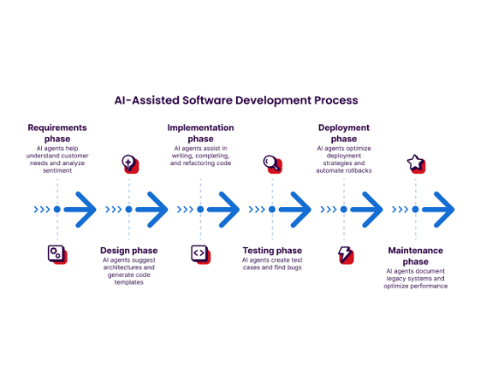
SECTION 2.1.1 — SDLC IMPACT
How SDLC Models Dictate Testing
Sequential Models (Waterfall, V-Model)
Phase-gated approach. Dynamic testing occurs after code completion.
Iterative & Incremental (Agile)
Continuous validation within sprints. Testing overlapping development.
DevOps & Continuous Delivery
Automated pipeline execution on code commit. Rapid automated feedback.

Slide 4
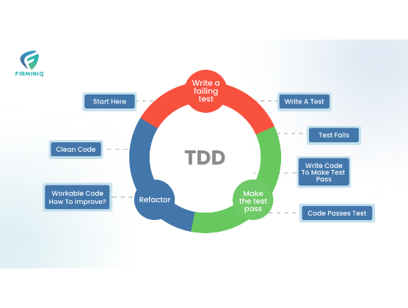
SECTION 2.1.3 — TEST-FIRST APPROACHES
Testing as a Driver for Development
TDD
Test-Driven Development
Tests written before code. Follows strict Red-Green-Refactor developer cycle.
ATDD
Acceptance Test-Driven
Team derives acceptance tests collaboratively before implementing features.
BDD
Behavior-Driven Development
Scenarios defined in Given-When-Then format readable by business and QA.

Slide 5
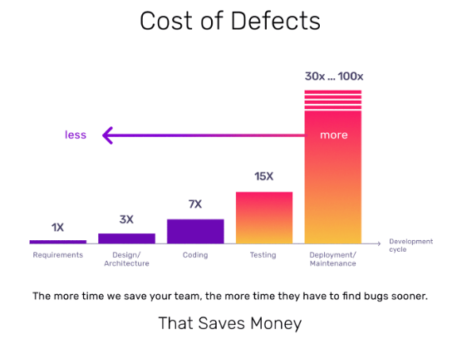
SECTION 2.1.4 & 2.1.5 — SHIFT LEFT & DEVOPS
DevOps Alignment & Shift-Left Mindset
Shift-Left Principle
Performing testing activities earlier in the SDLC. Early static reviews and unit tests prevent costly downstream defect fixes.
Continuous Delivery Pipeline
Automated regression suites run continuously on CI/CD code commits, providing instant feedback to development teams.

Slide 6
SECTION 2.1.2 & 2.1.6 — BEST PRACTICES
Good Testing Practices & Retrospectives
01
02
03
04
Corresponding Test Activities
Distinct Test Levels
Early Analysis & Design
Retrospectives
Each level maintains specific objectives and scope boundaries.
Test analysis begins during design and requirement definition.
Iterative review meetings drive continuous quality improvement.
Every software development activity has a matching test phase.

Slide 7
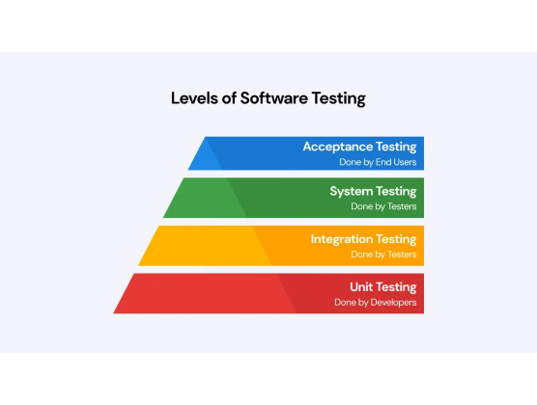
SECTION 2.2.1 — TEST LEVELS
The Four Standard Test Levels
1. Component Testing
Focuses on isolated modules, units, or classes. Driven by developers using mocks.
2. Integration Testing
Validates interactions and data flows between components or external systems.
3. System Testing
Evaluates end-to-end overall system behavior against functional specs.
4. Acceptance Testing
Validates readiness for release; driven by users, clients, or product owners.

Slide 8
SECTION 2.2.2 — TEST TYPES
Functional, Non-Functional & Structural Types
Functional Testing
Non-Functional Testing
Black vs. White Box
Evaluates system functions ("what it does"). Evaluates requirements and business process compliance.
Evaluates operational attributes ("how well"). Measures performance, security, reliability, and usability.
Black-box targets specifications. White-box targets internal architecture and code structure coverage.

Slide 9
SECTION 2.2.3 — CHANGE-RELATED TESTING
Confirmation Testing vs. Regression Testing
Confirmation Testing
Re-Testing
Regression Testing
Side-Effects
Target: Executing failed test cases after defect resolution.
Target: Testing unchanged parts of the application.
Objective: Detect unintended side-effects or broken functionality. Primary automation candidate.
Objective: Confirm original defect has been successfully repaired.

Slide 10
SECTION 2.3 — MAINTENANCE TESTING
Triggers for Maintenance Testing
1. Modifications
2. Migrations
3. Retirement
Planned enhancements, feature updates, emergency hotfixes, and defect corrections in live production.
Platform upgrades, database transfers, cloud migrations, and operating system updates.
System decommissioning, data archiving validation, and migration data retrieval checks.

Slide 11
SECTION 2.3 — MAINTENANCE SCOPING
Impact Analysis & Regression Scope
1
2
3
4
Evaluate Change
Assess Risk
Select Tests
Cost vs. Risk
Identify modified modules and architectural dependencies.
Measure potential impact severity on existing workflows.
Choose necessary regression test suites and new test cases.
Balance regression depth against release timeline targets.

Slide 12
EXAM PREPARATION SUMMARY
Chapter 2 Core Takeaways
SDLC Integration: Tailor testing to SDLC model; apply shift-left, TDD/BDD, and CI/CD pipelines.
Levels & Types: Combine functional, non-functional, black-box, and white-box testing across all four levels.
Maintenance Testing: Use impact analysis to determine regression testing scope for live software updates.
ISTQB® CTFL v4.0 Syllabus Alignment
6 Exam Questions (K1 / K2)

Slide 13




Image Sources
https://miro.medium.com/1*p6dRU_zYkpcCPtyUOyvVAQ.png
Source: medium.com
https://miro.medium.com/1*ehdOWtE5WhAqF1CZs9ioxg.png
Source: medium.com
https://cdn.prod.website-files.com/5eb9845c0972c01cdaec8415/63b49f08939f2bfb9d56454e_Cost-of-Defects.gif
Source: www.functionize.com
https://agiletest.app/wp-content/uploads/2025/06/levels-of-software-testing-by-agiletest-1024x576.webp
Source: agiletest.app

